Slide 1
Social Studies
Resource Use
Day 1

Slide 2
Learning Targets
I can identify the natural resources of the Missoula valley.
I can tell how those natural resources have been used, in the past and today.
I can identify how people have changed the physical environment of the Missoula Valley.
I can explore the effects these changes have had on the Missoula Valley.

Slide 3
Natural Resources
What are natural resources?
Natural resources are any materials we use that come from the earth.
Examples:
Wood for houses Water for drinking
Wood for paper Vegetables for food
Oil for gas Dirt for building

Slide 4
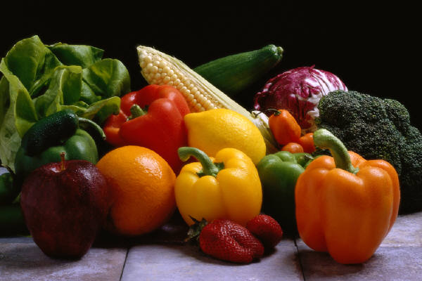
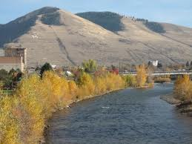
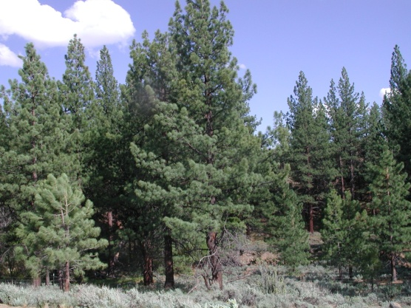
Missoula’s Natural Resources
What natural resources do we have in or near Missoula?
Water, trees (lumber), coal, natural gas, vegetables and fruit (produce), and air (clean air).

Slide 5
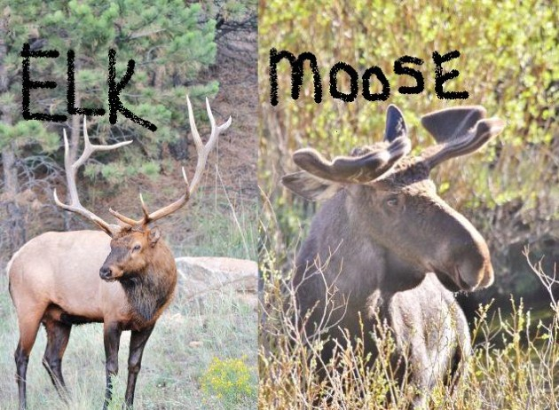
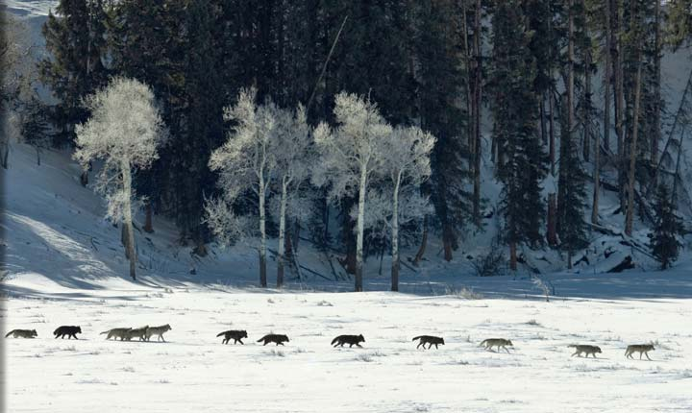
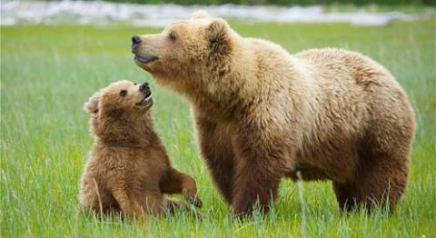
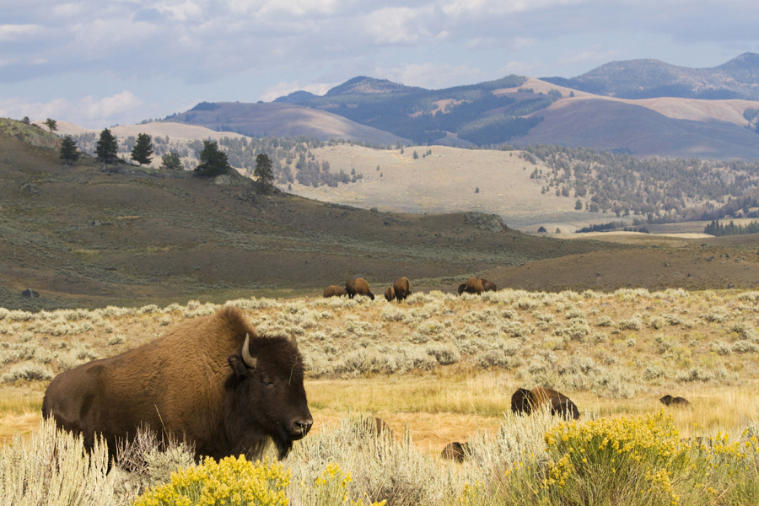
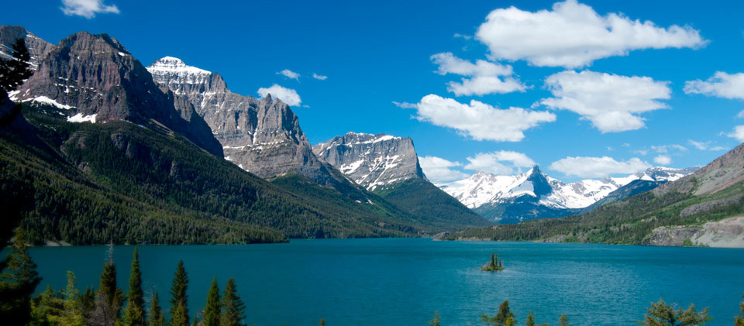
Missoula’s Natural Resources
We also have wilderness – wild lands
We also have wild animals!
People come to Montana to use the resources we have here.

Slide 6
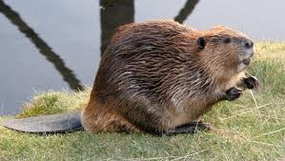

Montana’s Natural Resources
People have always come to Montana to use the natural resources found here.
Historically people came to hunt animals for fur (beaver).
Next they came to mine for gold, silver and copper.

Slide 7

Montana’s Natural Resources
People also came to log the timber (trees) to use for building homes and making paper.
Next people came to mine for coal and natural gas.

Slide 8
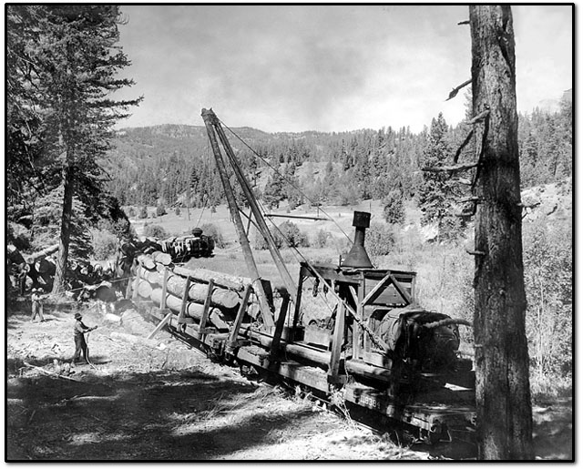
Missoula’s Natural Resources
A timber mill was built in Bonner (just 10 miles from Missoula) in the 1850’s to process the trees being logged in the near by mountains.

Slide 9
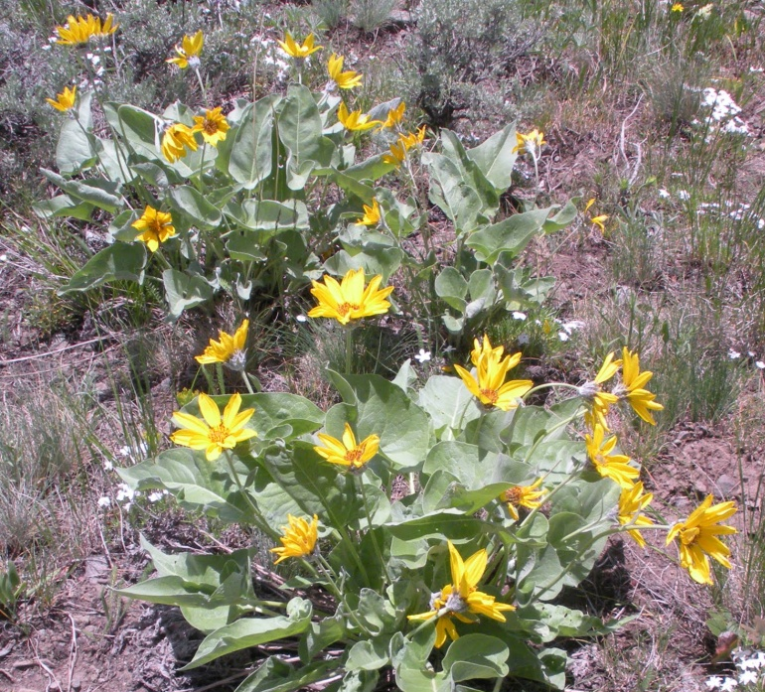
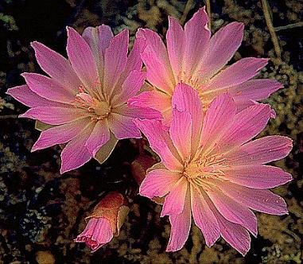
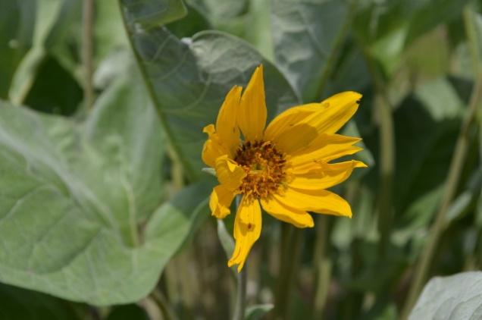
Missoula’s Natural Resources
Missoula valley has always been a place where people came to trade the resources they had.
Food and supplies were traded among local Native American tribes in Missoula valley.

Slide 10
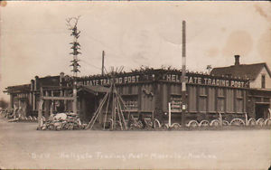
Missoula’s Natural Resources
In 1860 a trading post was built in Missoula by European settlers to make a place to trade furs, supplies and food.

Slide 11
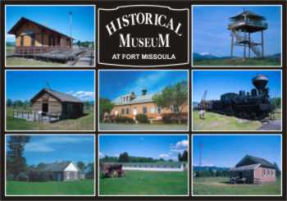
Missoula’s Natural Resources
A fort was built in 1877 to continue the trade and house the military.

Slide 12
Missoula’s Natural Resources
There were 3 men who founded (started) the city of Missoula:
  A.B. Hammond
  R.A. Eddy
  E.L. Bonner
The 1880’s saw the rise of the first city buildings.
In 1895 the University was built and started.

Slide 13
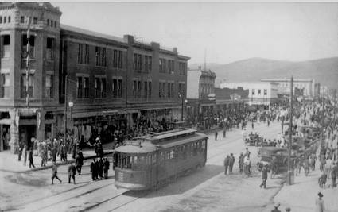
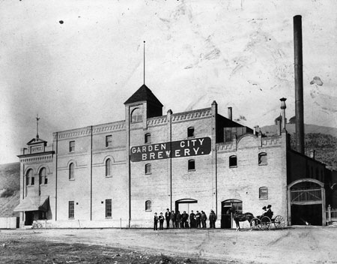
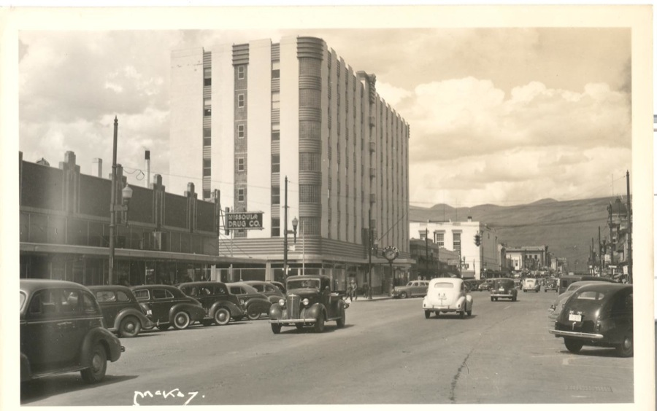

Slide 14
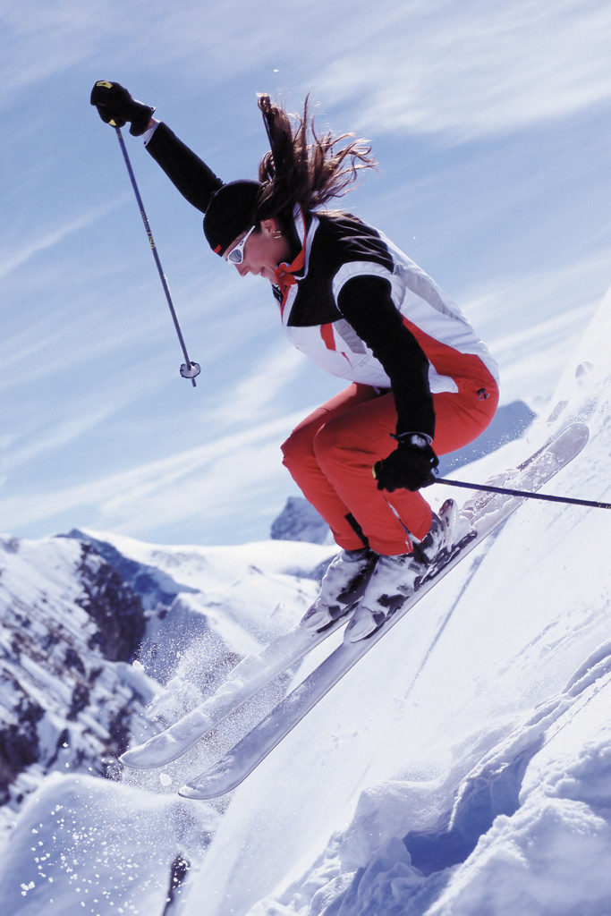
Missoula’s Natural Resources
Why do people move to Missoula now?

