Slide 1
Social Studies
Resource Use Day 2

Slide 2
Learning Targets
I can identify the natural resources of the Missoula valley.
I can tell how those natural resources have been used, in the past and today.
I can identify how people have changed the physical environment of the Missoula Valley.
I can explore the effects these changes have had on the Missoula Valley.

Slide 3
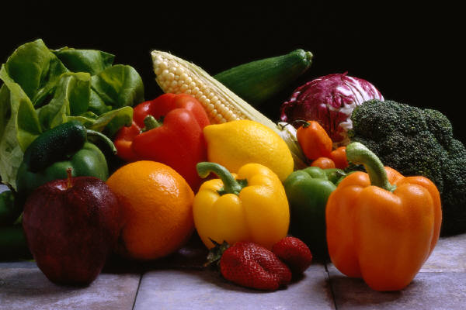
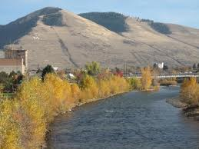
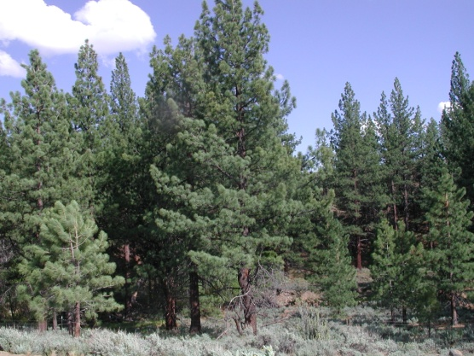
Missoula’s Natural Resources
What natural resources do we have in or near Missoula?
Water, trees (lumber), coal, natural gas, vegetables and fruit (produce), and air (clean air).

Slide 4
World Water
97.5% is saltwater can’t drink or grow with
2.5% is freshwater Freshwater
70% of freshwater from ice or snow in mountains
0.3% from lakes, rivers
30% from ground water

Slide 5
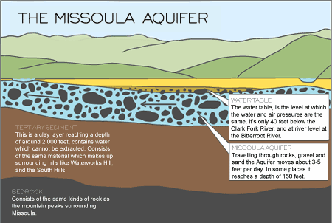
Missoula’s Water
We use the Missoula Aquifer for all our water needs.

Slide 6
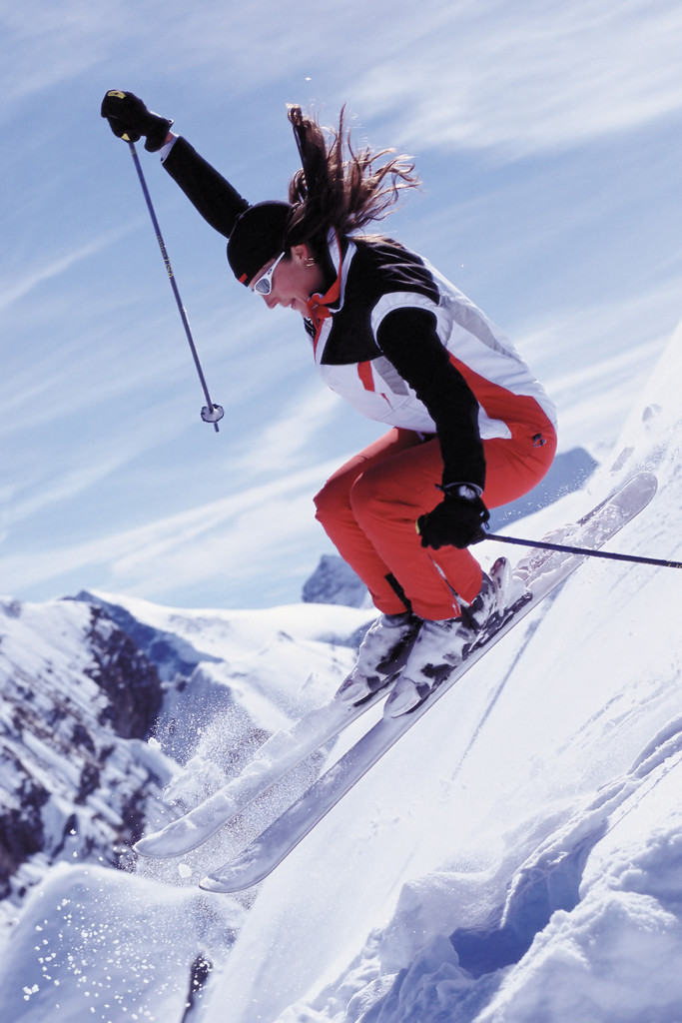
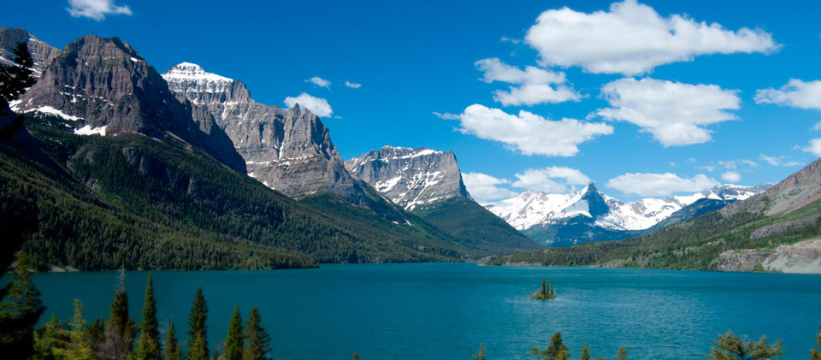
Missoula’s Natural Resources
Why do people move to Missoula?

Slide 7
Missoula’s Resource Use
People move and live in Missoula because of all the natural resources available here.
Water, trees (lumber), coal, natural gas, vegetables and fruit (produce), and air (clean air).

Slide 8
Missoula’s Water
Use the internet websites and your worksheets to research about water use in Missoula.
www.clarkfork.com
www.mtnwater.com/aahquifer.htm

