Slide 1
Social Studies
Sustainable Resource Use
Day 3

Slide 2
Learning Targets
I can identify the natural resources of the Missoula valley.
I can tell how those natural resources have been used, in the past and today.

Slide 3
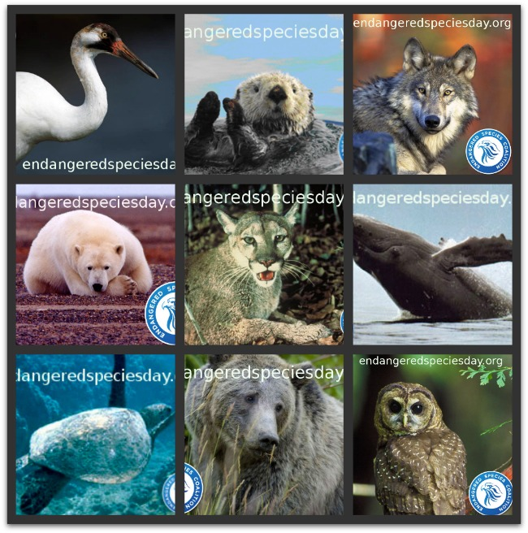
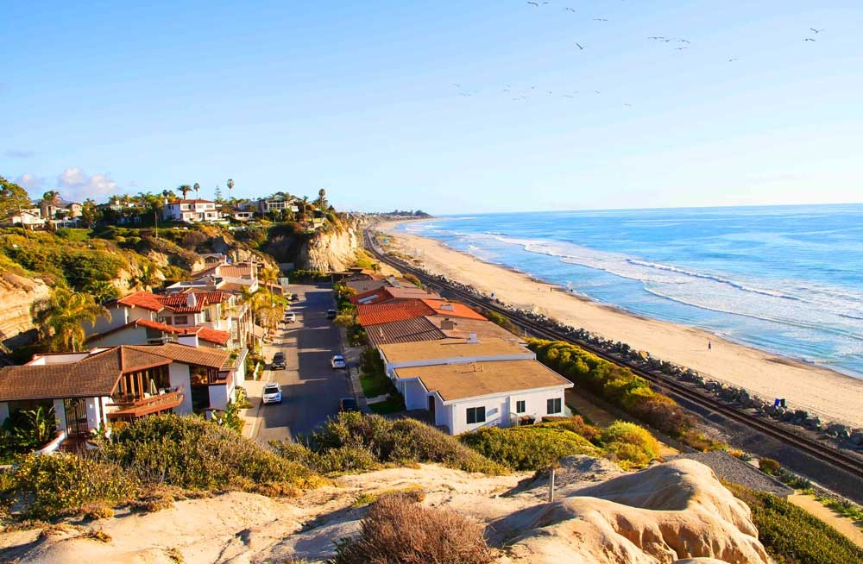
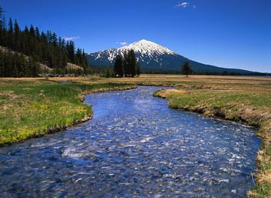
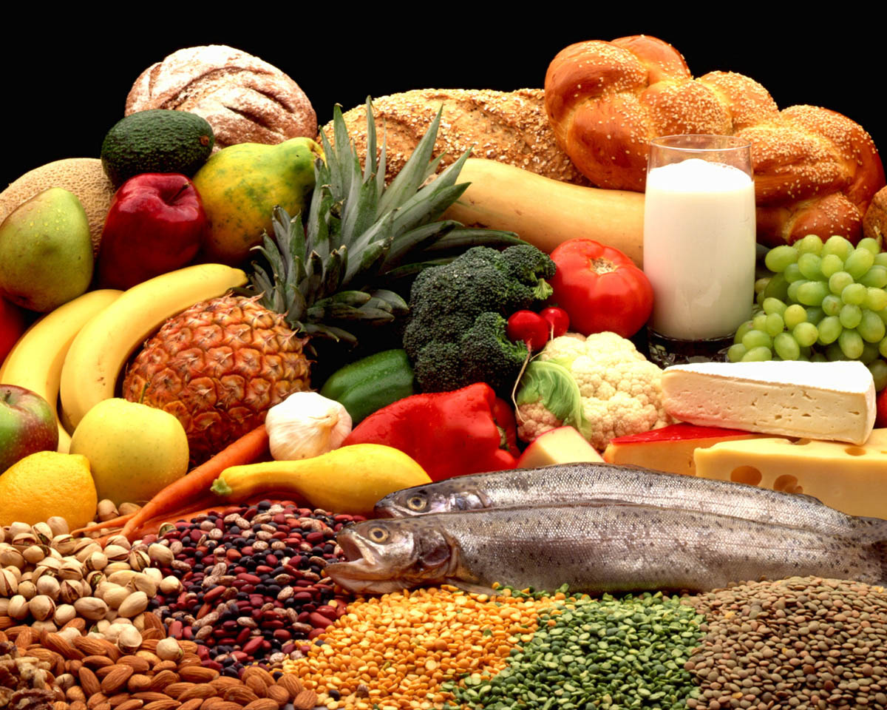
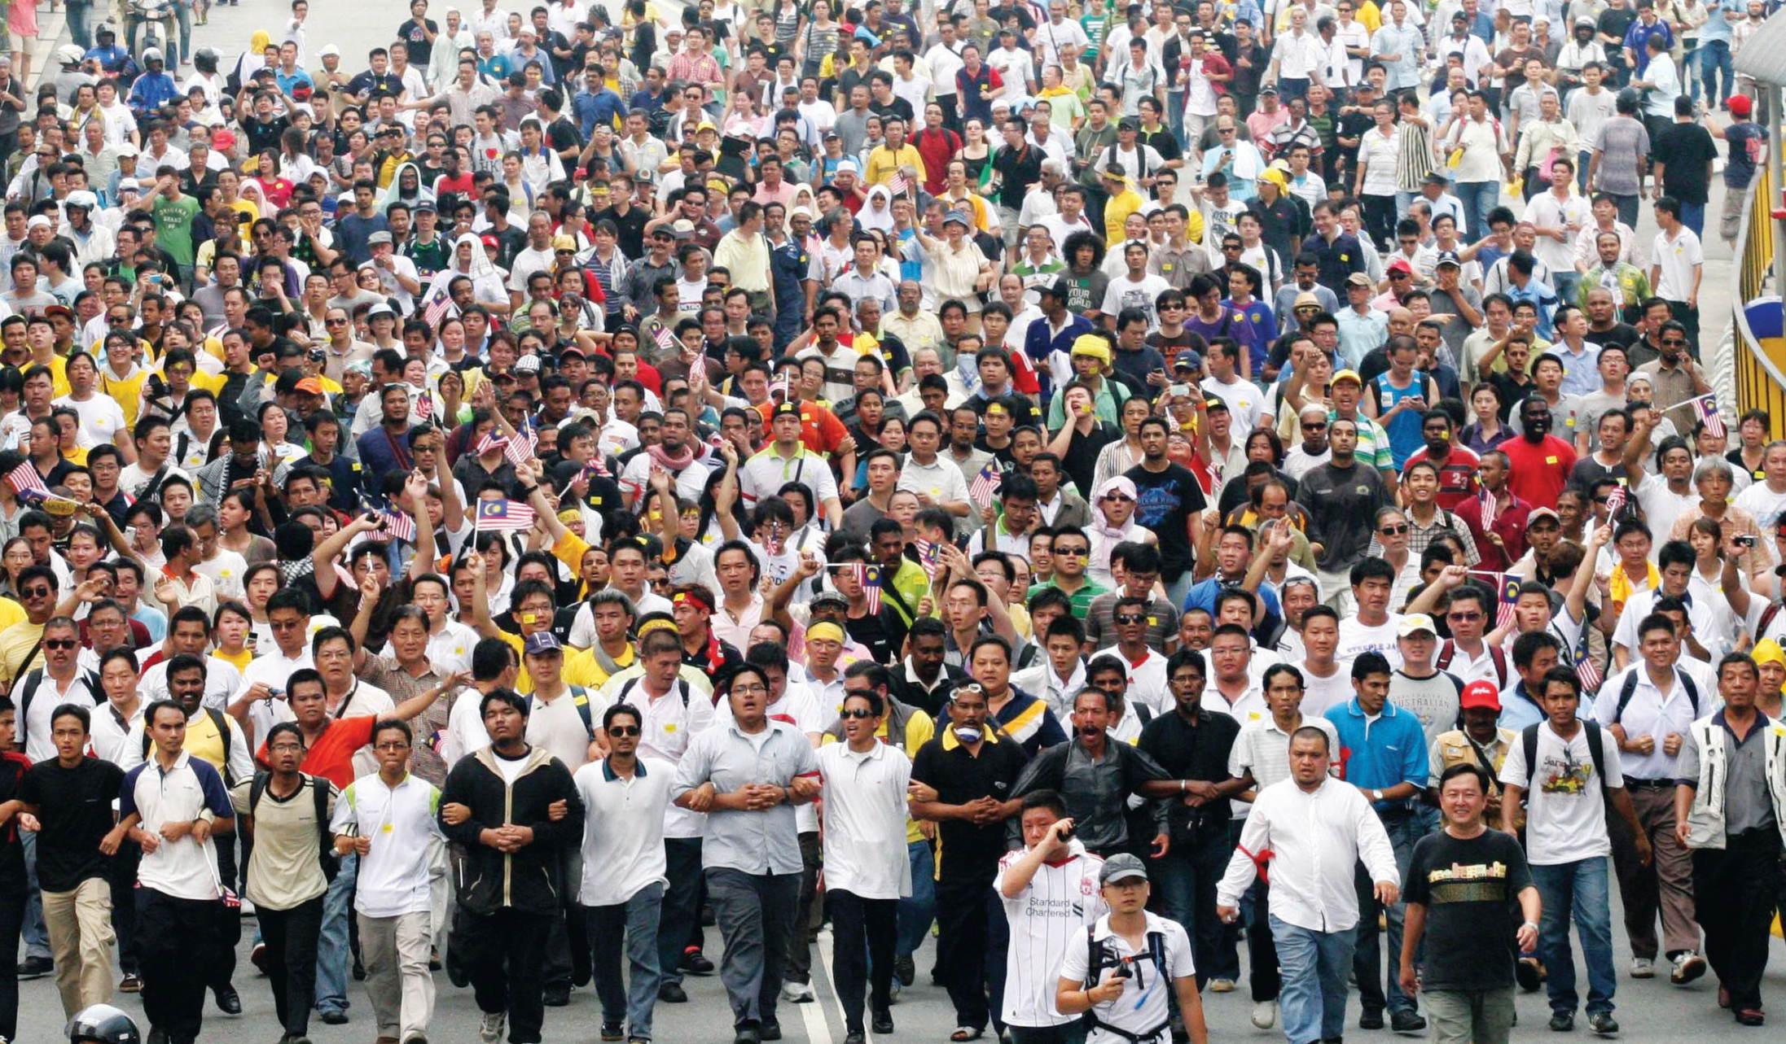
Sustainable
Able to keep going at the same rate, forever.
Human Population
Resource Availability/Use
Food Production/Use
Natural Systems – weather, ocean currents
Animal populations

Slide 4
Sustainable
Sustainable development is a development principle for human life on a finite planet. It hopes for a good future for humans in which living conditions and resource-use meet human needs without hurting the sustainability of natural systems and the environment, so that future generations may also have their needs met.
Finite = having limited amounts.

Slide 5
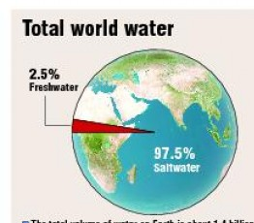
World Water – Finite Resource
97.5% is saltwater
can’t drink or grow with
2.5% is freshwater
Freshwater
70% of freshwater from
ice or snow in mountains
0.3% from lakes, rivers
30% from ground water

Slide 6

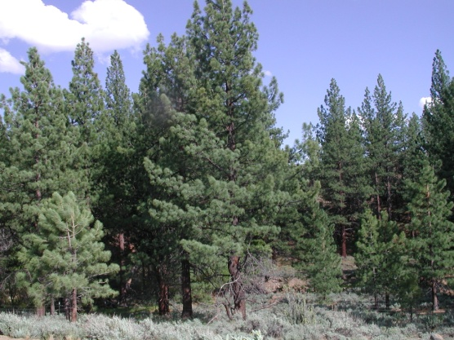
Renewable
A resource that can be made again without much effort.
Wind
Sunshine
Trees – in areas where they grow fast
Waterpower – in areas where water is strong

Slide 7
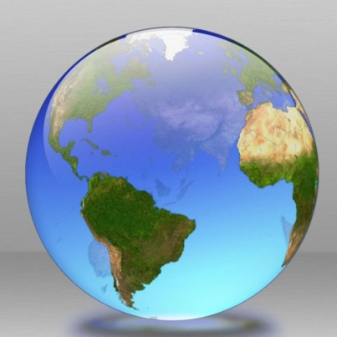
Earth Day
April 22nd of each year
Started in the U.S. in 1970 as a grassroots movement
    Grassroots movement: done by several different small groups of people – not done by the government.
Now celebrated by over a billion people worldwide.

