Slide 1
Social Studies
Sustainable Resource Use Day 4

Slide 2
Learning Targets
I can identify the natural resources of the Missoula valley.
I can tell how those natural resources have been used, in the past and today.

Slide 3
World Water – Finite Resource
97.5% is saltwater can’t drink or grow with
2.5% is freshwater
Keeping in mind how precious freshwater is let’s look at Missoula’s water.

Slide 4
Missoula’s Water - News
Missoula depends on the underground aquifer for all of it’s water needs.
Until 2011 water in the aquifer was owned by city of Missoula.
In 2011 the Carlisle Group in California bought our water – now they own it and we pay them to use it.

Slide 5
Missoula’s Water - News
Sept. 2011 - Mountain Water owns rights to the Missoula aquifer and the Rattlesnake drainage, including four of the most senior water rights on Rattlesnake Creek. The sale of Mountain Water and parent company Park Water to the Carlyle Group was an estimated $102 million transaction in all, water rights included.

Slide 6
Missoula’s Water - News
October 2013 – City approves Mayor John Engen’s goal of buying back water rights
May 2014 – Mayor John Engen still trying to negotiate buying back the water rights.

Slide 7
Missoula Aquifer
Clarkfork River feeds the aquifer
Rattlesnake Creek feeds the aquifer
Snowmelt feeds the aquifer from mountains all over the Missoula area

Slide 8
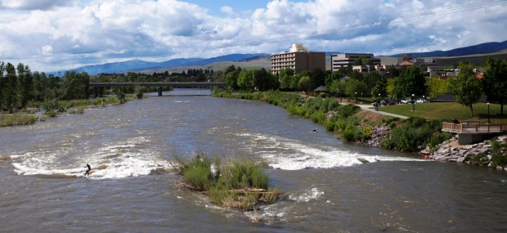
Missoula’s Resource Use
Clarkfork River - also used for year round recreation
Brennan’s Wave (man made in 2006) – made to add whitewater kayaking to the Missoula area.
Named after Brennan Guth, local Missoulian whitewater kayaker who died in Chile in 2001 in a kayaking accident.

Slide 9
Missoula’s Water
Use the internet websites and your worksheets to research about water use in Missoula. The first website is where we went last time.
www.clarkfork.org
www.mtnwater.com/aahquifer.htm

