Slide 1
Suki’s Kimono: Traditional World Outfits
I can compare and contrast different traditional outfits from around the world.
Pg. 166

Slide 2
Locations Around The Wolrd
World Map
Japan - Kimono
United States - Moccasins
Chile - Poncho
France - Berets
China - Qipao
India - Sari

Slide 3
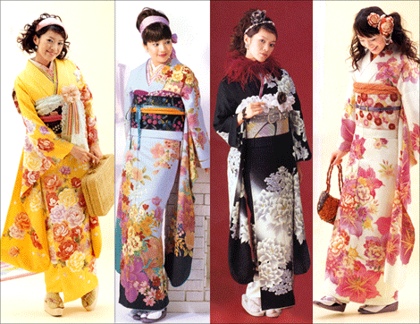
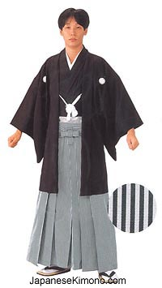
Kimono
Design influenced by Chinese Hanfu clothing style and worn in Japan as early as 5 A.D.
Traditionally worn by both men and women everyday, samurai and sumo wrestlers included.
Now mostly just worn for special occasions

Slide 4
South American Poncho: pg.167 Native American Moccasins: pg. 168 French and Spanish Berets: pg. 169

Slide 5
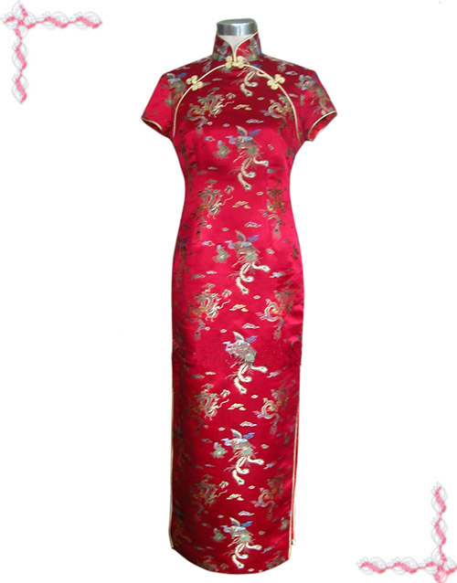
Chinese Chipao – Mandarin Gown
Created in the 1920’s in Shanghai
Known as a Chipao (Mandarin) or Cheongsam (English version of Cantonese word)
Now worn mostly in Hong Kong and Taiwan, formal attire for special occasions

Slide 6
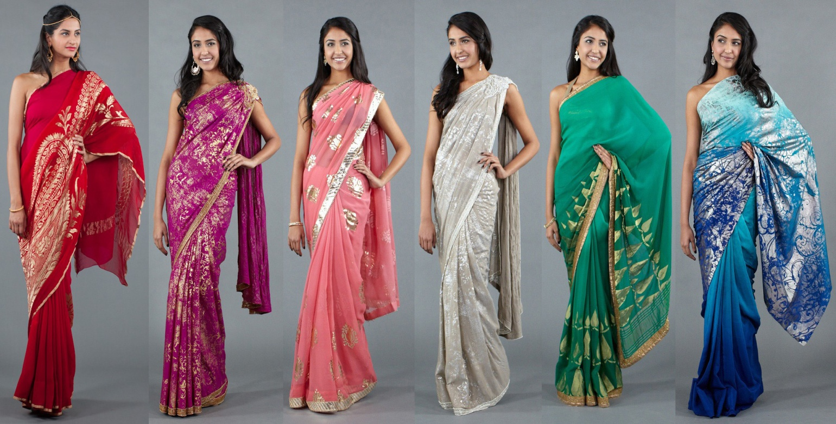
East Indian Sari
Worn in India as early as 2800-1800 B.C.
A strip of cloth ranging from 2-9 yards in lengh and 2-4 feet in width
Still worn today by women for everyday attire

